Slide 1
Learning Aim B
Management and Leadership Styles and Skills

Slide 2
Leading by example – class discussion
How do employees feel when leaders ‘hide away in their offices’ and just ‘give orders’?
Do good leaders lead by example or only give orders?
How do employees feel when leaders get involved in all aspects of the business? When leaders go beyond what is expected of them and act as role models. Example – Waitrose, Store manager putting stock out and saying goodbye to all before leaving.
This fosters a team or family business community.

Slide 3
Management and Leadership Styles
As we go through each leadership style, think of advantages and disadvantages of them:
Autocratic style – power and control, strict obedience to authority
Democratic/Participative – involves team members in decision making
Paternalistic – dominant paternal/maternal figure
Laissez-faire – hands off and free- reign
Transactional – adapt own behaviour to suit employees skills and the situation
Transformational – leader looks to strengthen employee through investing in them
Charismatic – engages and motivates people through his/her own motivational attitude

Slide 4
Management and leadership skills
Think of some skills that leaders and managers may have
Setting objectives (SMART)
Motivating
Decision making
Team building
Leading by example
Consulting
Problem solving
Supporting others
Managing conflict
Building positive relationships
Using emotional intelligence – ability to accurately read others emotions
Communicating giving feedback

Slide 5
Consulting
Both managers and leaders need to consult with others – internal and external stakeholders. This could be to resolve problems or ask experts for help with specific problems such as product specialists or engineers.
Skills required for consulting:
Understand your own limitations
Interpreting and listening
Comparing and analysing
Summarising
Critical thinking
Decision making

Slide 6
Problem Solving
All leaders solve problems on a daily basis, and problems need solutions.
Think of some problems that can arise in a business such as Lea Valley, then think of a solution to that problem? E.g. a teacher calling in sick.
Problem-solving skills:
Creativity
Organising
Reflecting
Assessing risks
Planning

Slide 7
Valuing and supporting others
Supporting others should not be patronising, but instead empowering.
You should ensure that all staff feel valued and supported by having regular catch-ups and recognition schemes and performance appraisals.
Can you think of an example of a time that a teacher or employee has wanted to support you, did this feel patronising or empowering?

Slide 8
Managing Conflict
Managers and leaders will have to manage conflict at various levels within a business.
Four steps to managing conflict:
Identify the issue or problem
Identify those in conflict
Express concerns to those involved – usually together
Listen actively

Slide 9
Using emotional intelligence
Emotional intelligence is the ability to accurately read someone else’s emotions, wants and needs.
Daniel Goleman (1995, 2001) defines emotional intelligence as ‘The capacity for recognising our own feelings and those of others, for motivating ourselves, for managing emotions well in ourselves and in our relationships’.

Slide 10
Daniel Goleman (1995, 2001)
Identify the issues
Self-awareness
Social-awareness
Relationship-management
Self-management

Slide 11
Communicating
Communication includes:
Non-verbal signals
Active listening
Speaking
Observing
Interpreting what is being communicated to you
Thinking
Synthesising

Slide 12
Providing feedback
Managers often have to provide feedback as part of the appraisal process and it can sometimes motivate/de-motivate. The feedback should be structured against the goals and standards that were expected of the employee.
Key rules when providing feedback are that it must be:
Well considered
Justifiable
Easy to understand
Honest
Impartial
SMART

Slide 13
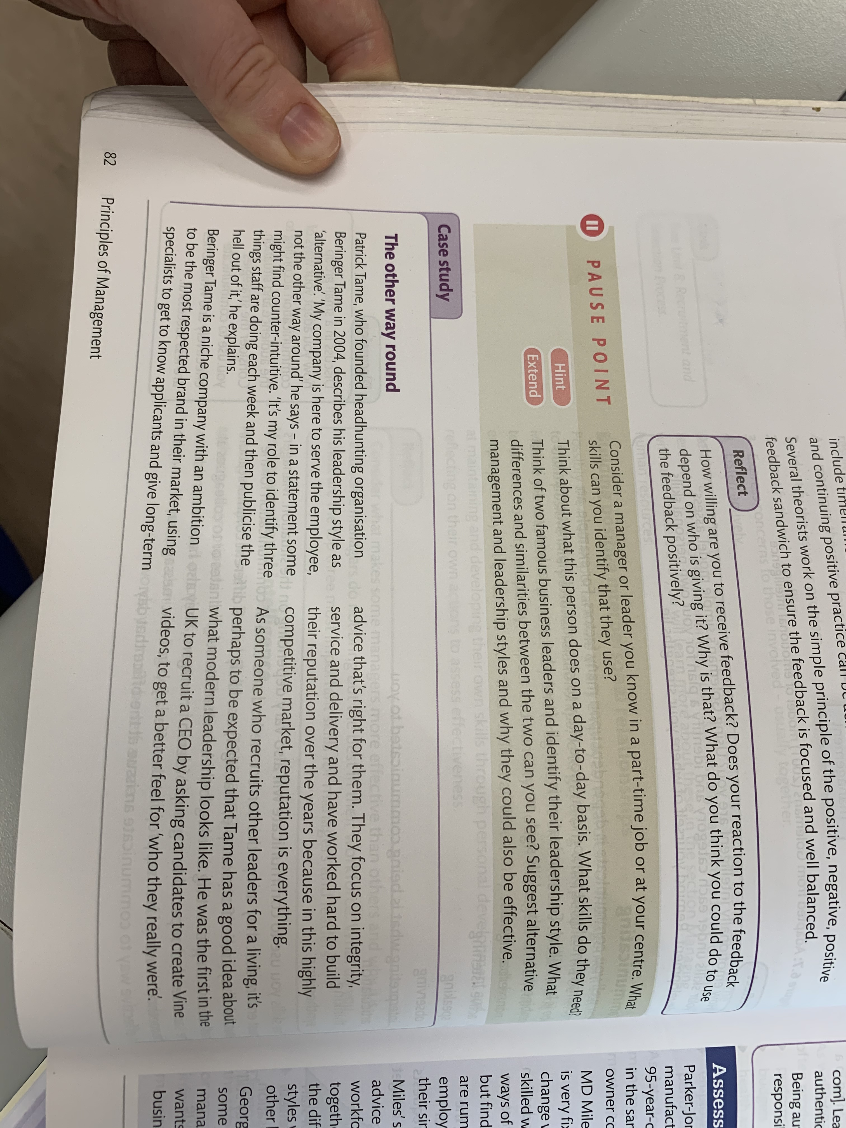
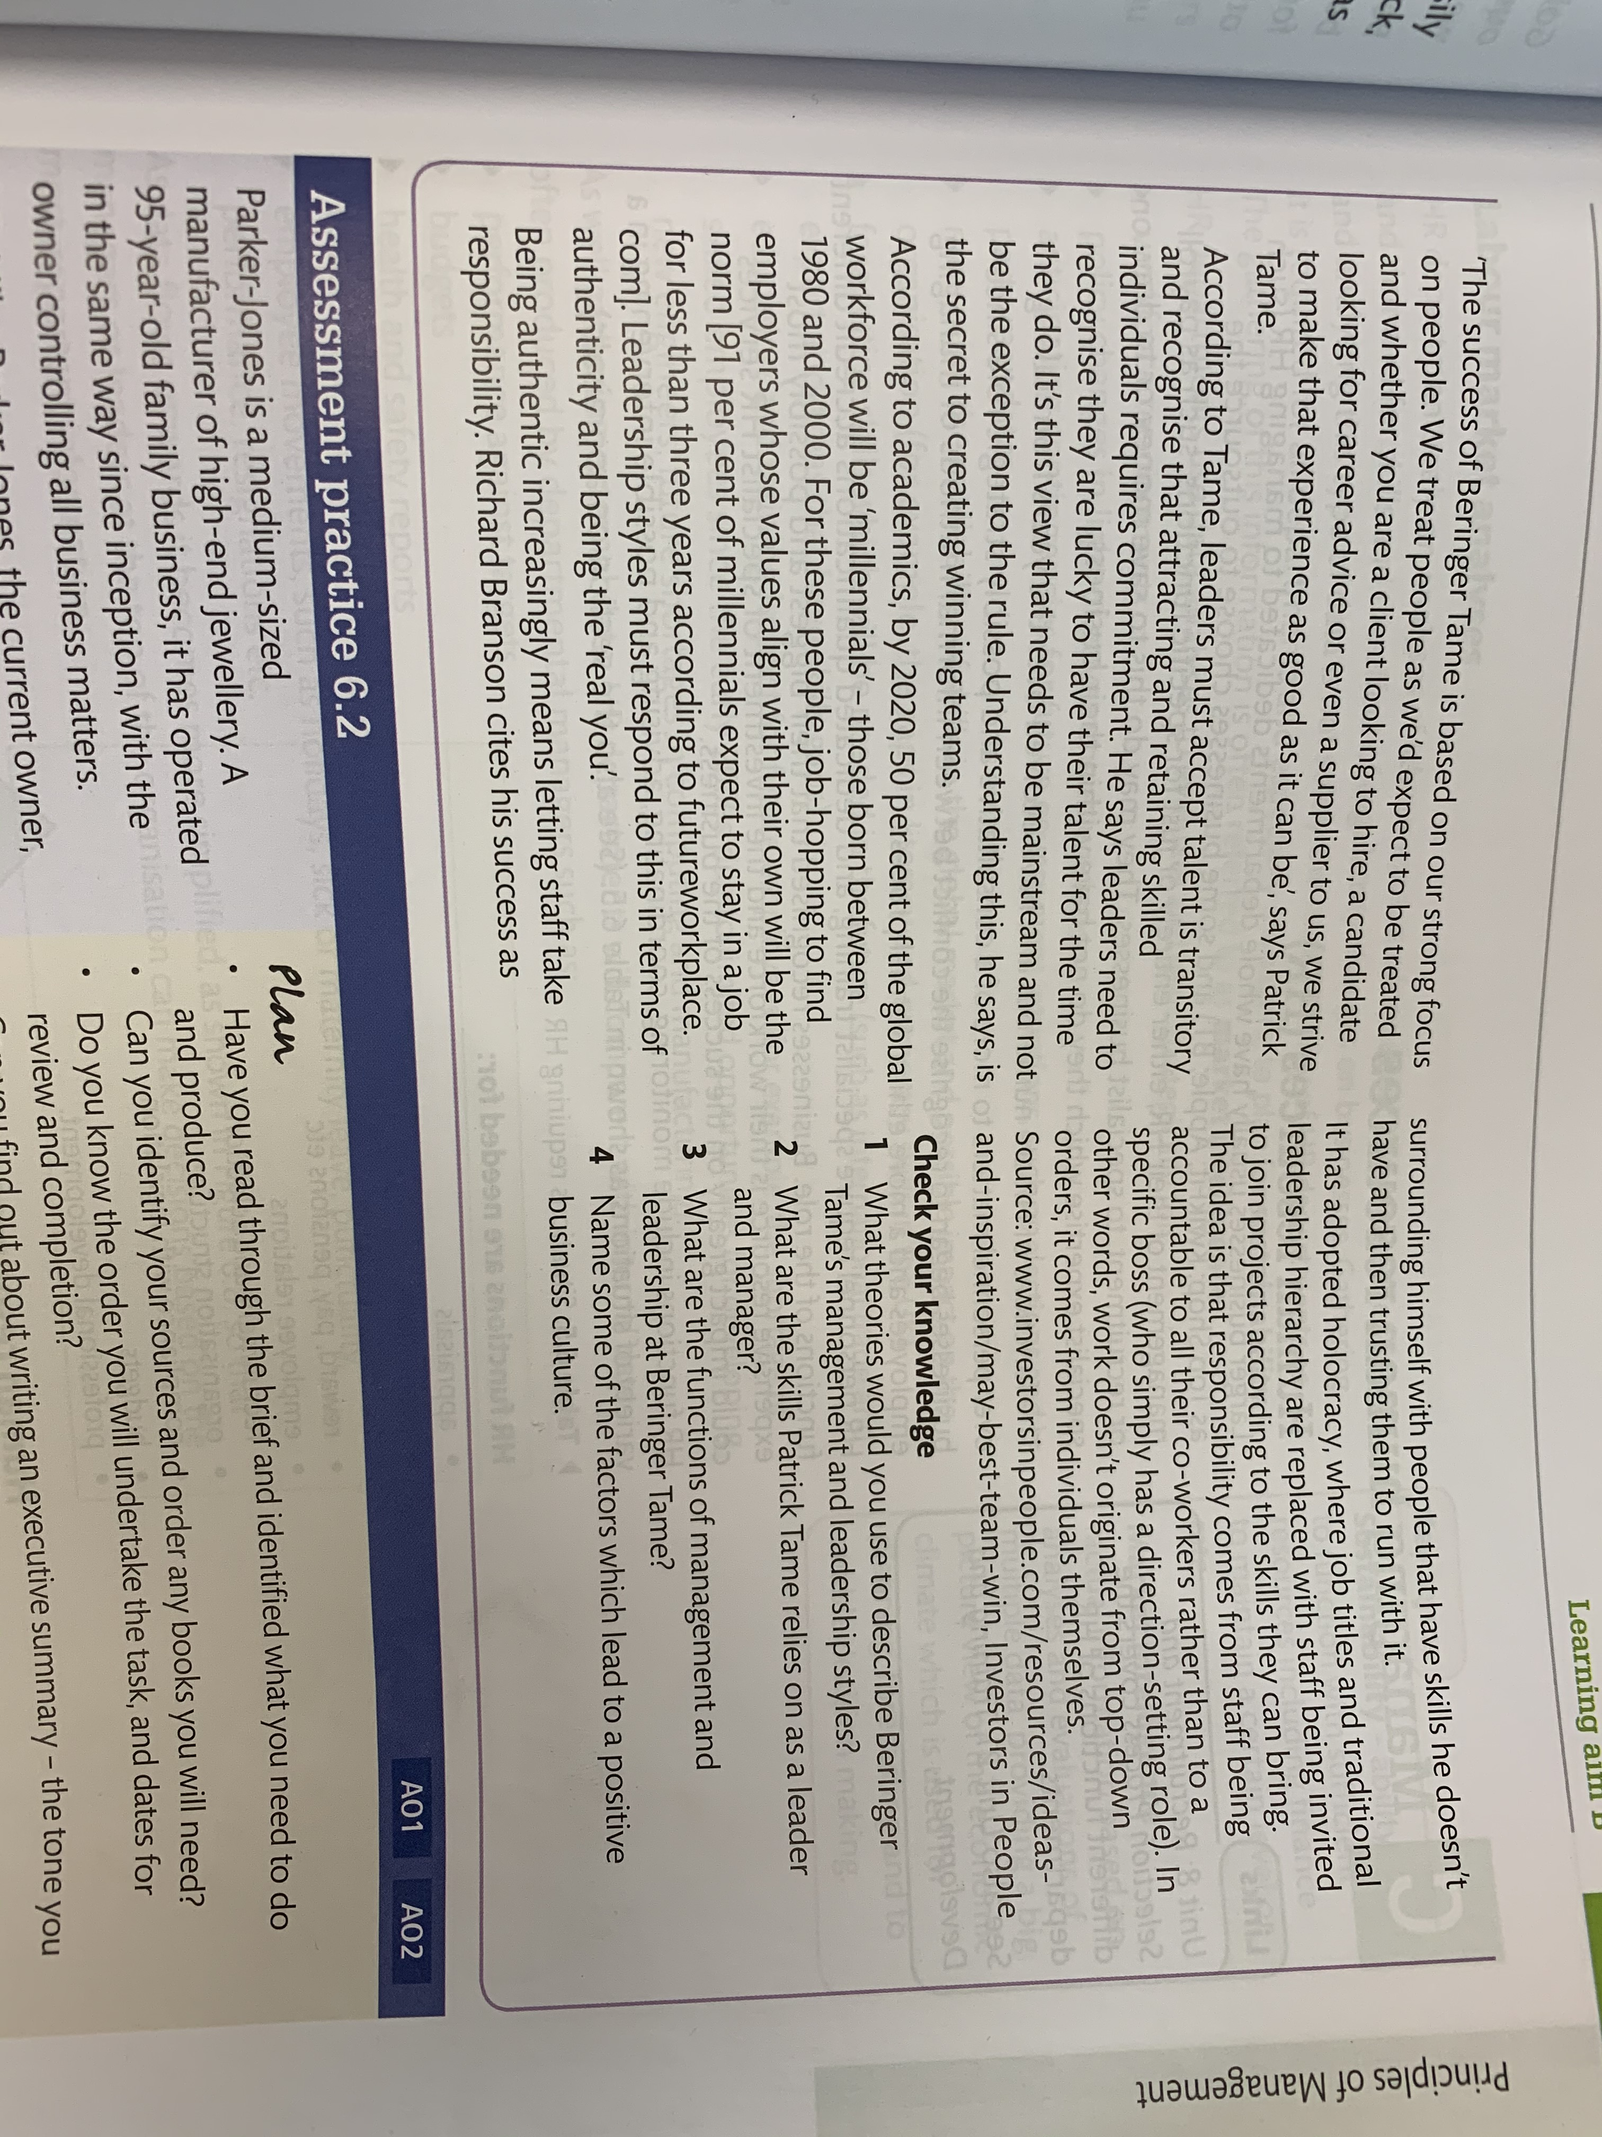
Please read through “The other way round” on page 82 and 83 and answer the questions

Slide 14
Check my learning:
1. How do we adapt the way that we communicate according to the audience and situation?
Ext: Evaluate (make a judgement) the ways that we use to communicate effectively and which ones are less successful?

